Slide 1

Wheat Impurities' Detection
Presented By:
* Abanoub George
* Mai Mahmoud
* Ibrahim Fawzy
* Nour Bahaa
Supervised By:
* Prof. Khalid Hussein
* Eng. Hager Sobeah
* Eng. Nour El-Huda Ashraf

Slide 2

Agenda.
Introduction.
Problem Background.
Existence Solution.
Our Challenge.
Our Solution.
Related Work.
Possible Solutions.
System Overview.
Expected Results.
Demo

Slide 3
Old system vs New system.
New System:
Wild Oat Detection.
Wheat Rust(3 kinds).
Weather Monitoring using IoT & APIs.
Old System:
Wild Oat Detection.

Slide 4
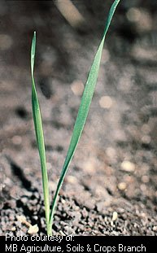


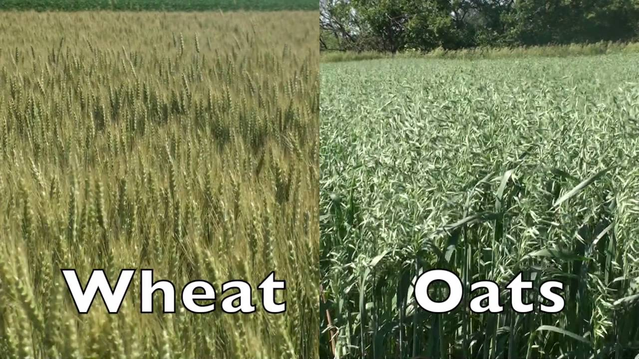
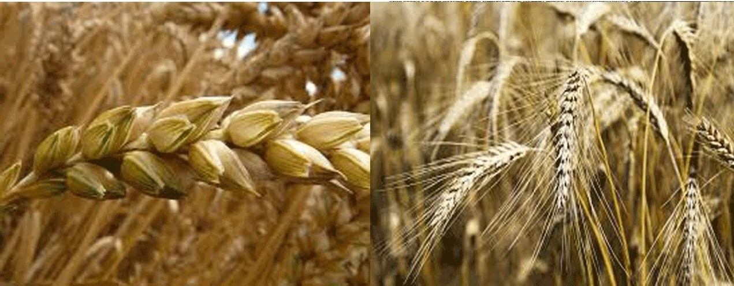
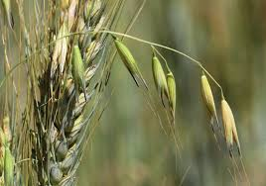
Introduction.
Data Collecting
Image Processing
Deep Learning
Wild Oats.
If spread what happens ?
1
Problem Background.
2
Existence Solution.
3
Our Challenges.
4
Our Solution.
93%
3/4
15 cm
100 to 150
7 to 8
Chemicals
Remove by Hand
Winter Plant
Lie Agriculture irrigation
In Egypt, 9 million tons
14 million tons
23 billion pounds
Wheat
Oats
Their disadvantages

Slide 5
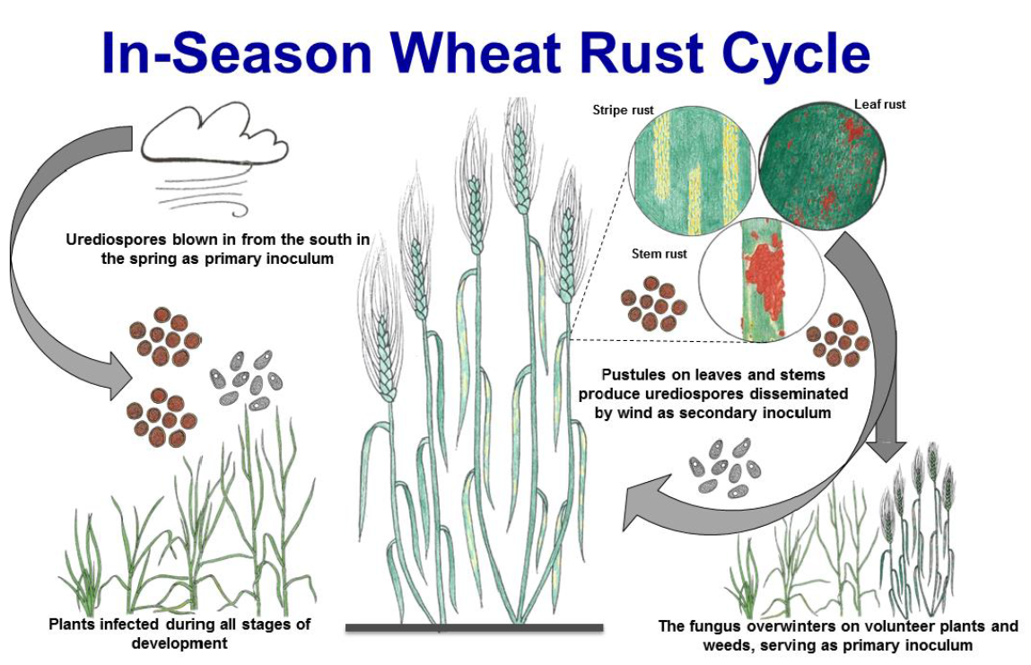
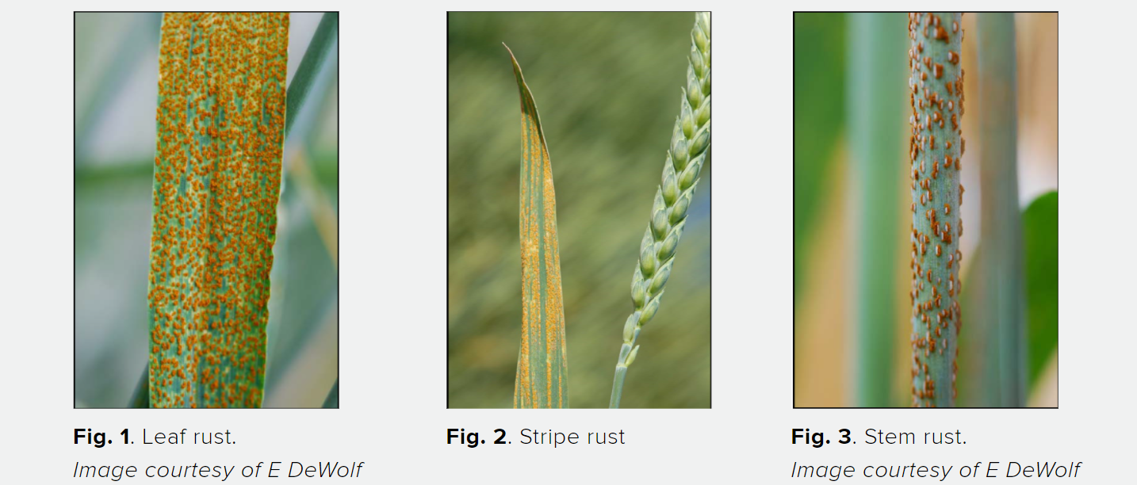
Introduction.
Rust Disease
Differentiate
Measure
Wind Speed
Prediction
Quantity
Quality
Reduce
10%
70%
Loses
Delta Egypt
23%
Reached
Expansion
Level
Time
Color Types
1
Problem Background.
2
Our Challenges.

Slide 6
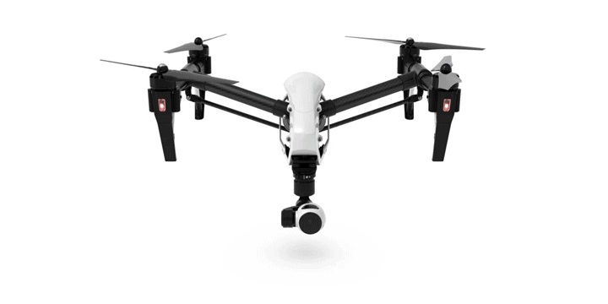
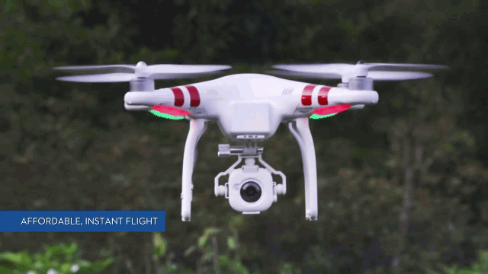
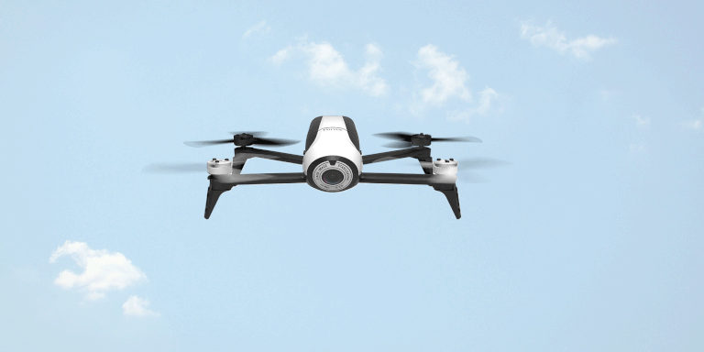
Related Work(1/3).
Detection of Weed and Wheat using image processing
Stages
Dataset
Results
UAV
Green
Yellow
15,000 image
Image Processing using CNN
[1] S. Hameed and I. Amin, "Detection of Weed and Wheat Using Image Processing," 2018 IEEE 5th International Conference on Engineering Technologies and Applied Sciences (ICETAS), Bangkok, Thailand, 2018, pp. 1-5, doi: 10.1109/ICETAS.2018.8629137.

Slide 7
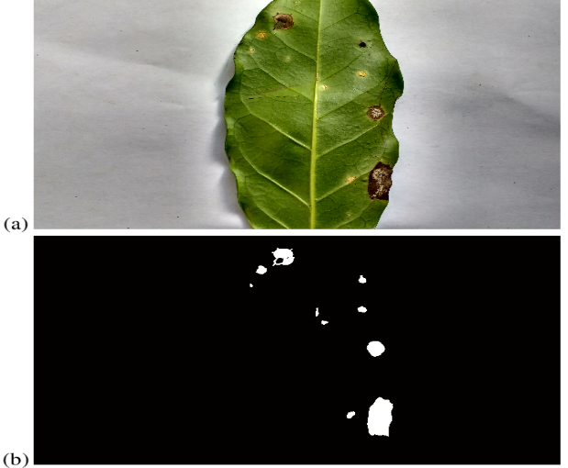
Related Work(2/3).
Coffee Leaf Rust Detection Using Convolutional Neural Network
Drop in coffee production of up to 45%.
Dataset
Results
159 image
Build CNN using Tensorflow library
[2] A. P. Marcos, N. L. Silva Rodovalho, and A. R. Backes. Coffee leaf rust detection using convolutionalneural network. In2019 XV Workshop de Visão Computacional (WVC), pages 38–42, 2019.

Slide 8
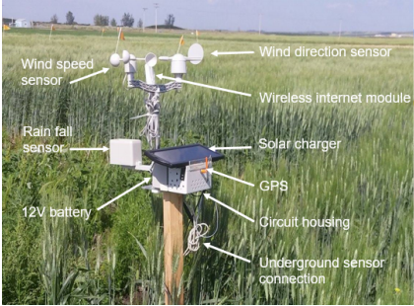
Related Work(3/3).
An IoT Environmental Data Collection System for
Fungal Detection in Crop Fields
Decreasing annual production.
The growth and spread of rust is heavily influenced by environmental conditions.
Results
2.4% each year
1.3% each year
[3] T. Truong, A. Dinh, and K. Wahid. An iot environmental data collection system for fungal detectionin crop fields. In2017 IEEE 30th Canadian Conference on Electrical and Computer Engineering(CCECE), pages 1–4, 2017.

Slide 9
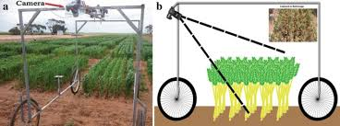
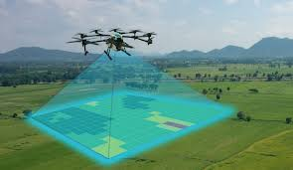
Possible Solutions.

Slide 10
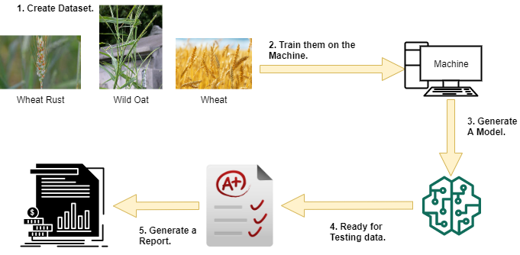
System Overview(1/2).
Model Creation.
Notes:
Model Creation:
At the beginning we started by a dataset that is going to be trained on a machine to generate a model. When the model is fed enough, it’s going to be ready for the evaluation phase and to generate stats and analysis.
System Overflow:
After our model becomes ready now we have to put it on a Raspberry Pi which is attached to a camera module. So our device will be ready to record videos of the field and sends them to the cloud for processing. Then the NN will start to detect the wild oat.

Slide 11
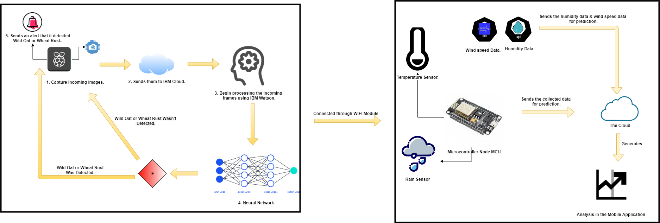
System Overview(2/2).
System Overflow.

Slide 12
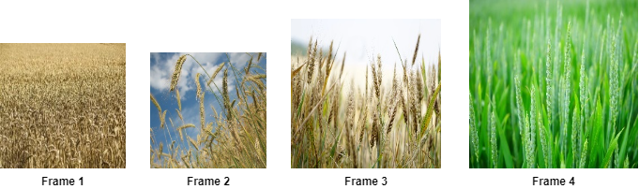
System Overview – Dataset.
Our Dataset is divided:
Healthy Wheat
Wild Oat
Wheat Rust
Leaf Rust
Stem Rust
Wheat itself Rust
We didn’t find a dataset
Agriculture Research Center Laboratory in Giza Government , in Cairo to collect it from them after a month
Notes:
Dataset:
Our dataset, which is considered a challenge for us consists of 2 main classes wheat and wild oat which are non normalized images.
We already have a dataset for wheat but for wild oat we don’t have so one of our contributions is that we are going to build a dataset for the wild oat.

Slide 13

System Overview -- Input.
Our input will be through incoming frames from the camera module to the Cloud service.
Notes:
Input:
Our input will be through incoming frames from the camera module to the IBM Cloud data service.

Slide 14
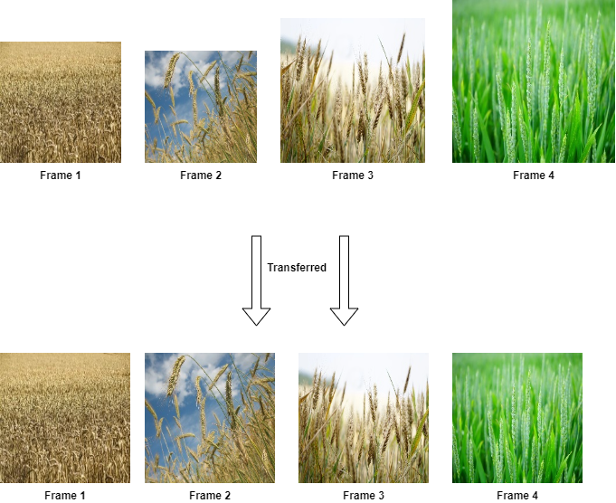
System Overview -- Pre-Processing.
Normalized data makes Neural Network works better. So, in the pre-processing stage our model must normalize the incoming frames by giving them same target size for all the images and divide them into batches.
[1] V. Sathya Durga and T. Jeyaprakash, "An Effective Data Normalization Strategy for Academic Datasets using Log Values," 2019 International Conference on Communication and Electronics Systems (ICCES), Coimbatore, India, 2019, pp. 610-612, doi: 10.1109/ICCES45898.2019.9002089.
Notes:
Pre-Processing:
According to the paper “An Effective Data Normalization Strategy for Academic Datasets using Log Values," , it summarizes how normalized data will make the NN works better than with normal data.

Slide 15
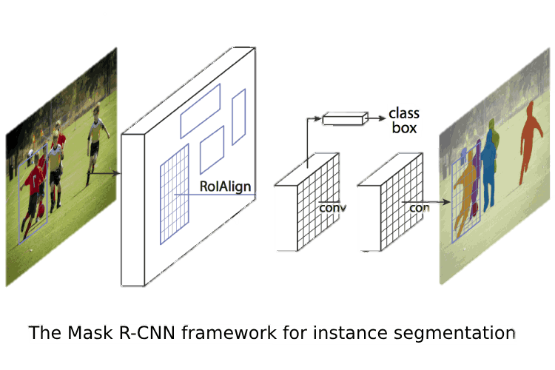
System Overview -- Main Processing.
The main processing phase is where we train our model with the dataset images so it can detect our incoming frames using TensorFlow and Keras python libraries to use the Mask R-CNN for detection phase.
[1] K. He, G. Gkioxari, P. Dollár and R. Girshick, "Mask R-CNN," 2017 IEEE International Conference on Computer Vision (ICCV), Venice, 2017, pp. 2980-2988, doi: 10.1109/ICCV.2017.322.
Notes:
Main Processing:
In the main processing phase is where we train our model with the dataset images so it can detect our incoming frames using TensorFlow and Keras python libraries to use the Mask R-CNN for detection phase.

Slide 16

System Overview -- Output.
The output of our system will end in one of the two ways either,
Our system doesn’t detect a wild oat/wheat rust and continue capturing videos of the filed.
Our system detects a wild oat/wheat rust, then it will make the buzzer, which is connected to the Raspberry Pi rings.
Notes:
Output:
The output of our system will end in one of the two ways either,
Our system doesn't detect a wild oat and continue capturing videos of the filed.
Our system detects a wild oat, then it will send a notification to the mobile app that their is a wild oat and the buzzer, which is connected to the Raspberry Pi will rings to tell him that there is a wild oat here and he should remove it.

Slide 17
Expected Results.
Early Detection & Classification.
Our model will be trained to detect the wild oat and wheat rust from the wheat in the early stage.
Prediction.
Once our weather forecasting system has been fully installed, it will detect a high-speed wind that has fungicides.

Slide 18
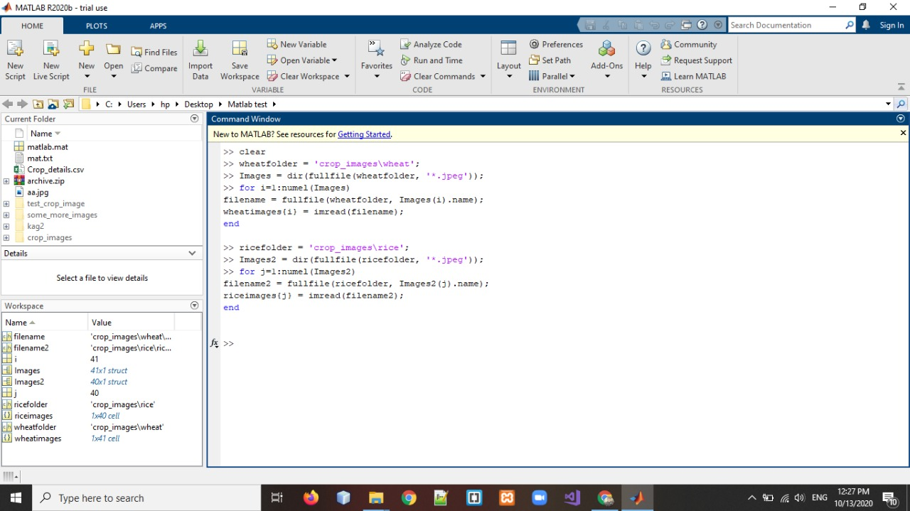
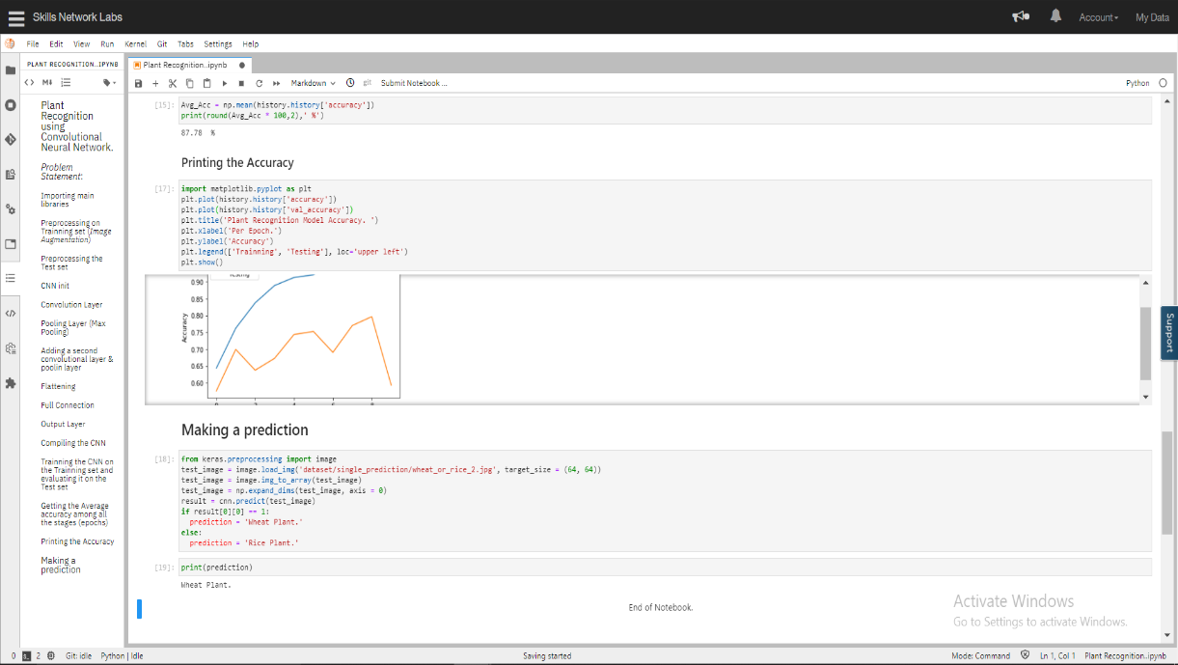
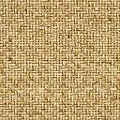
Demo
MATLAB Demo.
Python Demo.

Slide 19


